Slide 1



HANDYMAN
GUIDED BY:-
ZISHAN SHAIKH
PRESENTED BY:-
DHRUMIL SHAH
KAVIN SHAH
RAHIL SHAH
TATSAT TENDULKAR

Slide 2
INTRODUCTION
A platform for all the small-scale vendors, housewives and any other skilled people who are not getting enough time to showcase their skills due to many different reasons like less market knowledge, less awareness of how to target the customers, and because of large-scale companies who have acquired the market.
Our platform will help such skilled people to expand their businesses under their brand name and customers can afford their services at a reasonable cost.
Customized information about services is available to customers and they can view various services in a real-time environment via application.

Slide 3
LIMITATIONS OF THE EXISTING SYSTEM
For the existing systems as such there is no limitation except that all these systems prefer or employ large-scale companies according to users search preference.
Whereas the small-scale companies are not given proper listing.
The major limitation of the existing system is related to pricing, the prices are high which is not affordable to all customers.

Slide 4
OBJECTIVE OF THE NEW SYSTEM
Main objective of the system is to provide the small-scale businesses a platform to share their services directly with the customers for their utilization.
Provide the customers more options for various services from different vendors.
Provide customers with more options with affordable prices, as compared to prices offered by large scale companies.

Slide 5
PROBLEM DEFINATION
Our application aims to provide the small-scale businesses a platform to provide their services to the customers as well as to provide the customers with more options to choose from.
Unfortunately, the applications that provide various services for home requirements mostly prefer large-scale businesses according to user’s search preference.

Slide 6
REQUIREMENT ANALYSIS
FEASIBILITY STUDY
REQUIREMENT OF SYSTEM
TOOLS AND TECHNOLOGY USED
PROJECT ESTIMATION

Slide 7
FEASIBILITY STUDY
Feasibility Study deals with the viability of the project. And how the project if viable is developed.
Feasibility Study includes:-
Market Analysis
Technical Analysis

Slide 8
MARKET ANALYSIS
Demand:-
High Demand from Customer
Target Market:-
Low-income
Middle class people
Competition:-
Market Channel and Outlets:-
UrbanClap, Housejoy, Bro4u, Task Rabbit
Play Store, App Store [Future], Website

Slide 9
TECHNICAL ANALYSIS
Facilities and equipment :-
Labor and management:-
Inputs:-
Google Play Store Account, Web Hosting, Advertisements
No Labor needed
Application, Website, Mobile ,Laptop

Slide 10
REQUIREMENT OF SYSTEM
Technical Requirements
Non-Technical Requirements

Slide 11
CUSTOMER
SR. NO. | PARAMETER | DESCRIPTION
1 | C01 | A customer shall be able to login to the system by providing Email-id and password.
2 | C02 | A Customer shall be able to register to the system by providing Firstname, Lastname, Email-id, Password and image.
3 | C03 | A customer shall be able to opt for the Forgot password option.
4 | C04 | A customer shall be able to navigate through list of services available and select a specific service form it.
5 | C05 | A customer shall be able to navigate through list of sub-services available for selected specific service and select a specific sub-service.
6 | C06 | A customer shall be able to navigate through list of vendors available for selected specific sub service and select a specific vendor for details.

Slide 12
SR.NO. | PARAMETER | DESCRIPTION
7 | C07 | A customer shall be able to view details of Vendor when a specific vendor is selected from a list of vendors. Details include Image representing Vendor , Vendor name, Description about vendor and Average rating given to Vendor.
8 | C08 | A customer shall be able to click “Contact Vendor” which will allow Customers to view details regarding Image, Name, Contact no and Email of Vendor.
9 | C09 | A Customer shall be able to see ratings by different users when “Rate Me” button is clicked. It includes Image representing user, name of user, Rating Description for Vendor, Rating given from 1 to 5 to Vendor.
10 | C10 | A customer shall be able to rate the Vendor by clicking “Add Rating” and the rating shall appear with all other customer ratings.
11 | C11 | A customer shall be able to edit details in the Future.
12 | C12 | A Customer shall be able to delete himself/herself from the system.

Slide 13
VENDOR
SR. NO. | PARAMETER | DESCRIPTION
1 | V01 | A Vendor shall be able to send Verification request in order to register himself/herself in application.
2 | V02 | A Vendor shall be able to login to the web system by providing Email-id and Password.
3 | V03 | A Vendor shall be able to register in web system after successful Verification by providing Firstname, Lastname , Contact No, Email-id, Description regarding services provided, Image representing Vendor.
4 | V04 | A Vendor shall be able to see the ratings given by different Customers.
5 | V05 | A Vendor shall be able to edit details in the Future.
6 | V06 | A Vendor shall be able to delete himself/herself from System after which vendor will no longer be available in the System.

Slide 14
ADMINISTRATOR
SR. NO. | PARAMETER | DESCRIPTION
1 | A01 | An Administrator shall be able to register in the web system.
2 | A02 | An Administrator shall be able to login to the web system by providing Email-id and Password.
3 | A03 | An Administrator shall be able to opt for the Forgot Password option.
4 | A04 | An Administrator shall be able to manage the database and all the tables inside the database.
5 | A05 | An Administrator shall be able to verify the Vendor or Vendor request.
6 | A06 | An Administrator shall be able to manage Vendor.
7 | A07 | An Administrator shall be able to manage Customer.
8 | A08 | An Administrator shall be able to delete himself/herself from the Web System.
9 | A09 | An Administrator shall be able to Verify the request regarding the Forget Password by Customer and Vendor and on successful Verification, Password will be sent to their registered Email-id.

Slide 15
NON-FUNCTIONAL REQUIREMENTS
AVAILABILITY
Degree to which the customers can rely on the system. The system will be available 24 hours.
CONFIDENTIALITY
Degree to which the system protects the data. Our system will maintain confidentiality of user data and allow only authorized users to access it.
RELIABILITY
Degree to which the system performs without failure. Our system is made to be highly reliable to the use.

Slide 16
SCALABILITY
Degree to which a system is able to expand its processing capabilities. Our system being object oriented is highly scalable as new modules can be added very easily as per requirements and Business growth.
INTEGRITY
Degree to which the data maintained by system is accurate and authentic. Our system maintains integrity of user data by verifying those who register themselves.
USABILITY
Ease with which user prepares inputs and interprets outputs through interaction with system. Our system is highly usable due to its modularity
MAINTANABILITY
Ease with which faults in system can be found and fixed. Our system currently has high maintainability as it is object oriented and each module is relatively simple to analyze.

Slide 17
TOOLS AND TECHNOLOGY USED
IDE
Android Studio
DATABASE
MongoDB
LANGUAGES
HTML
PALTFORM FOR DIAGRAMS
Lucid chart
Sublime Text Editor
Visual Studio Code
CSS
Bootstrap
JavaScript
NodeJS
Express.js
Java

Slide 18
COST ESTIMATION
Cost Estimation refers to the analysis of the components of the project and their costs in order to calculate the approximate total cost of the project.
The cost for Google Play Store Account is $25. It is a one time registration fee which we need to pay before we can upload an application.
Current Dollar price is Rs. 71.46 so in INR it will be , 25*71.46 =1786.5 Rupees

Slide 19
Cost to buy the domain name to make our Website available online (i.e. Web Hosting) this will include
Unlimited Domains
Unlimited Disk Space
Unlimited Transfer
Unlimited Email Accounts
Free Dedicated IP
Free SSL Certificate
1-Click Installation
New-PHP 7.1
The total price will be Rs. 399/month for 5 years of plan.
So the Initial cost to launch the project will be:-
= 1775.25 + 399
= 2174.25 Rupees
This is the cost for the 1st month after which the cost will be 399.

Slide 20
SYSTEM DESIGN
USE-CASE DIAGRAM
ACTIVITY DIAGRAM
SEQUENCE DIAGRAM
STATE DIAGRAM
CLASS DIAGRAM
E-R DAIGRAM

Slide 21
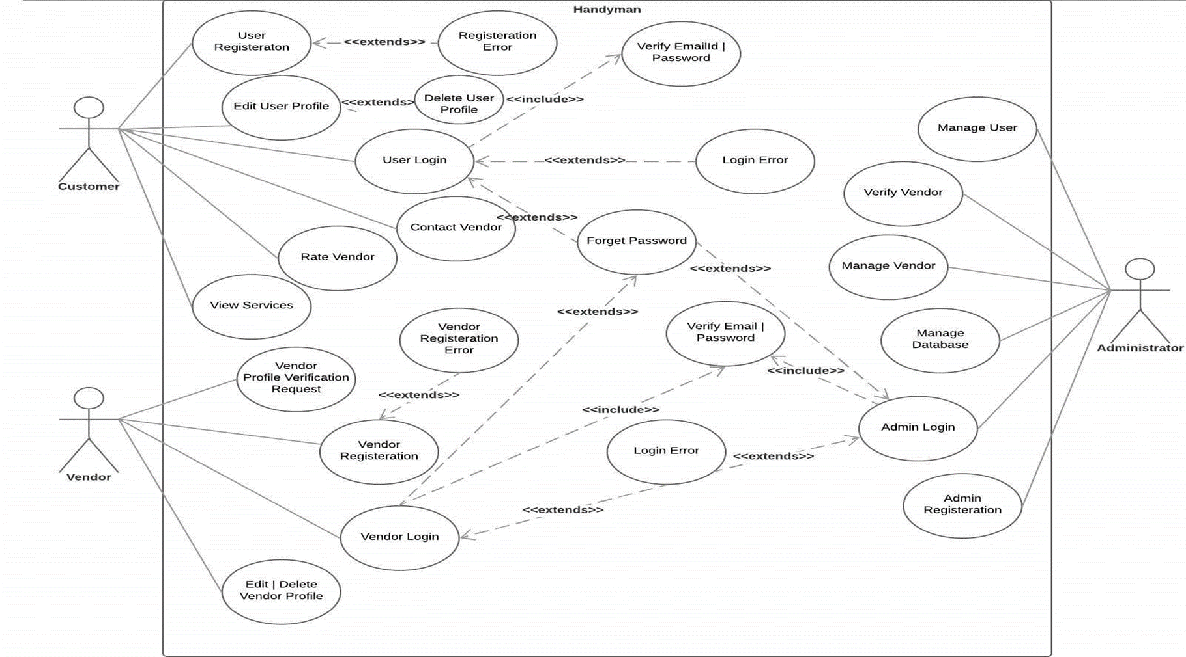
USECASE DIAGRAM

Slide 22
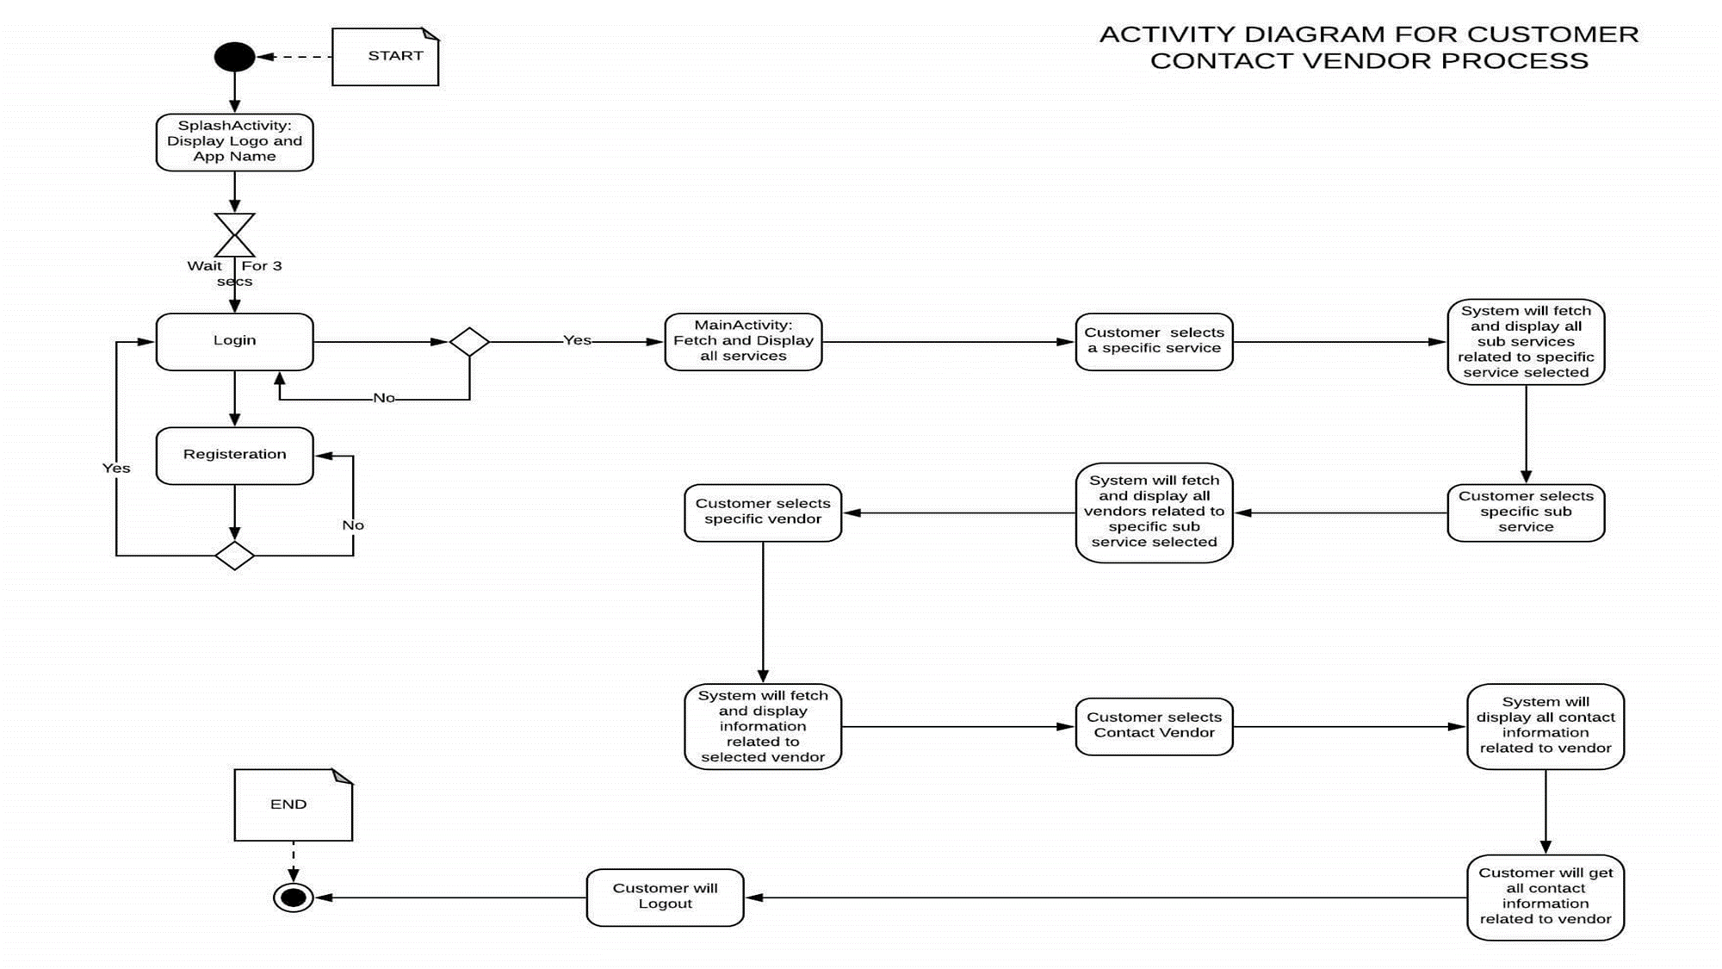
ACTIVITY DIAGRAM

Slide 23
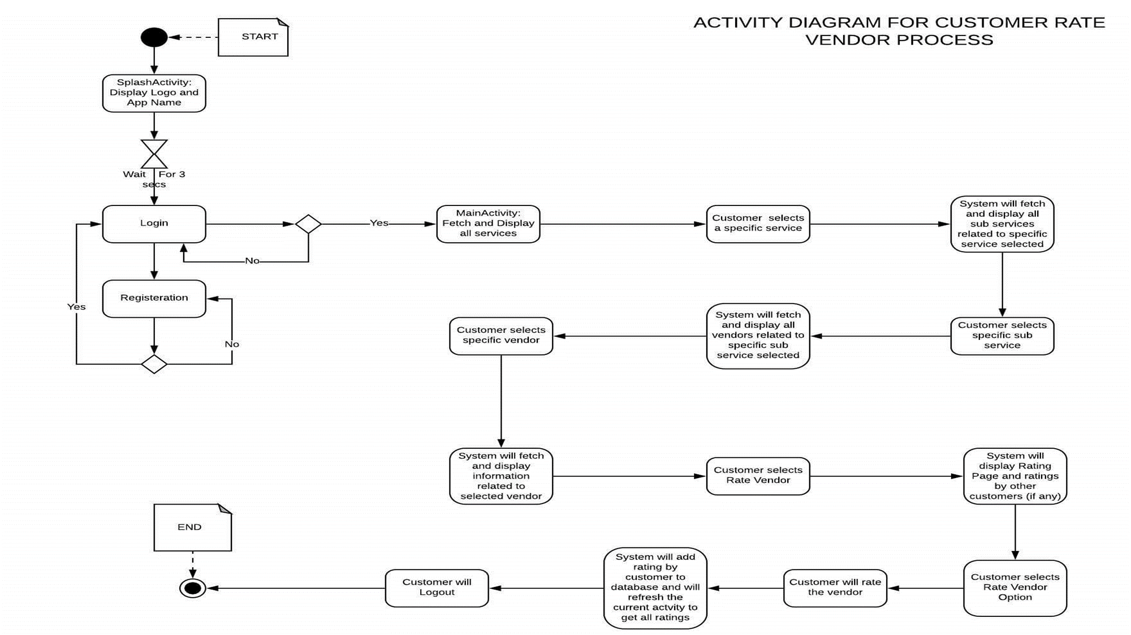

Slide 24
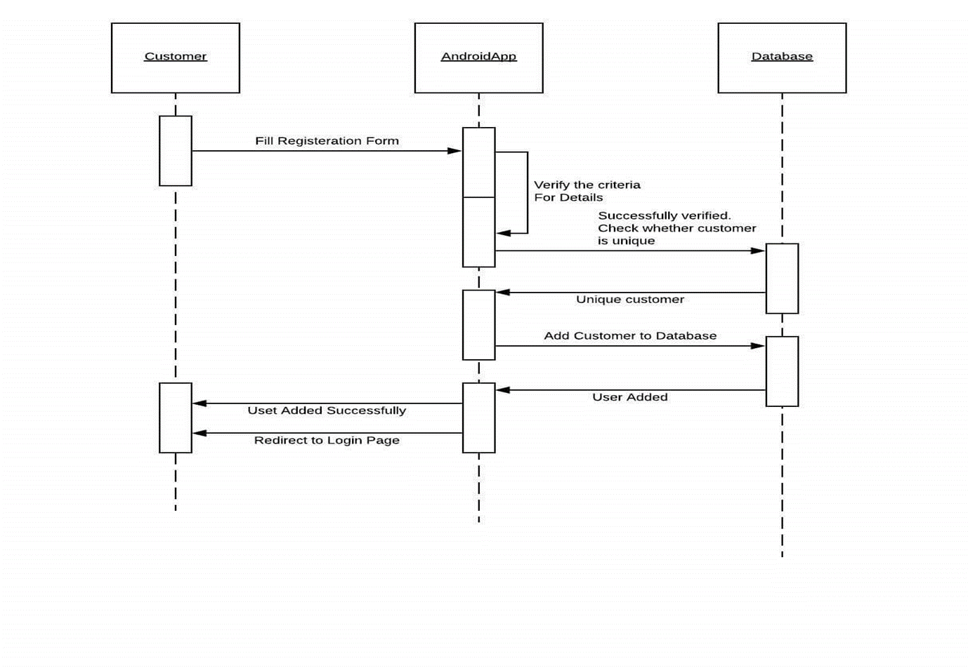
SEQUENCE DIAGRAM
Sequence diagram of customer

Slide 25
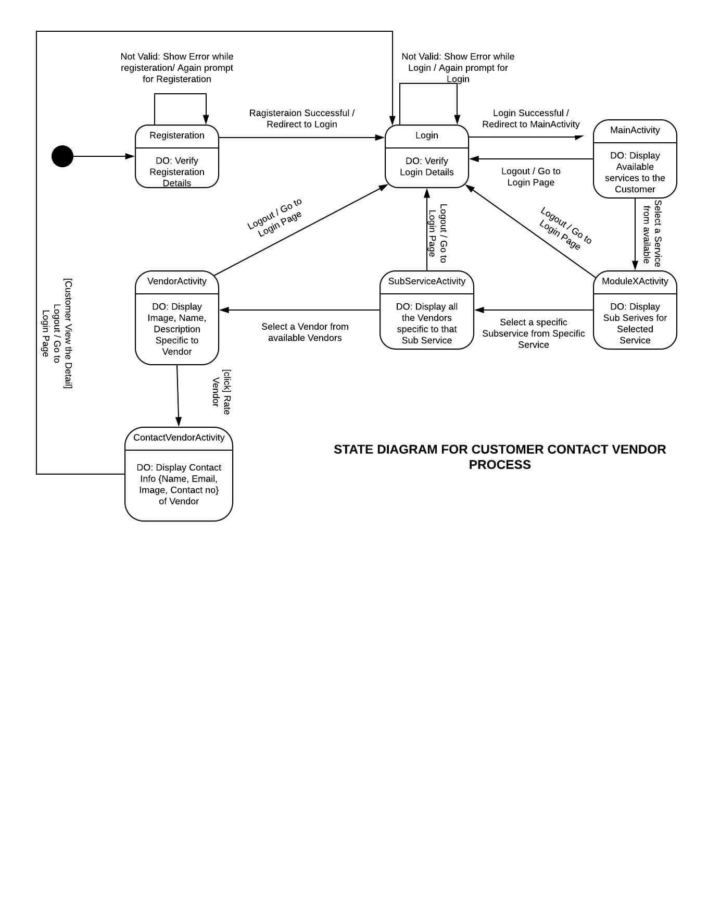
STATE DIAGRAM

Slide 26
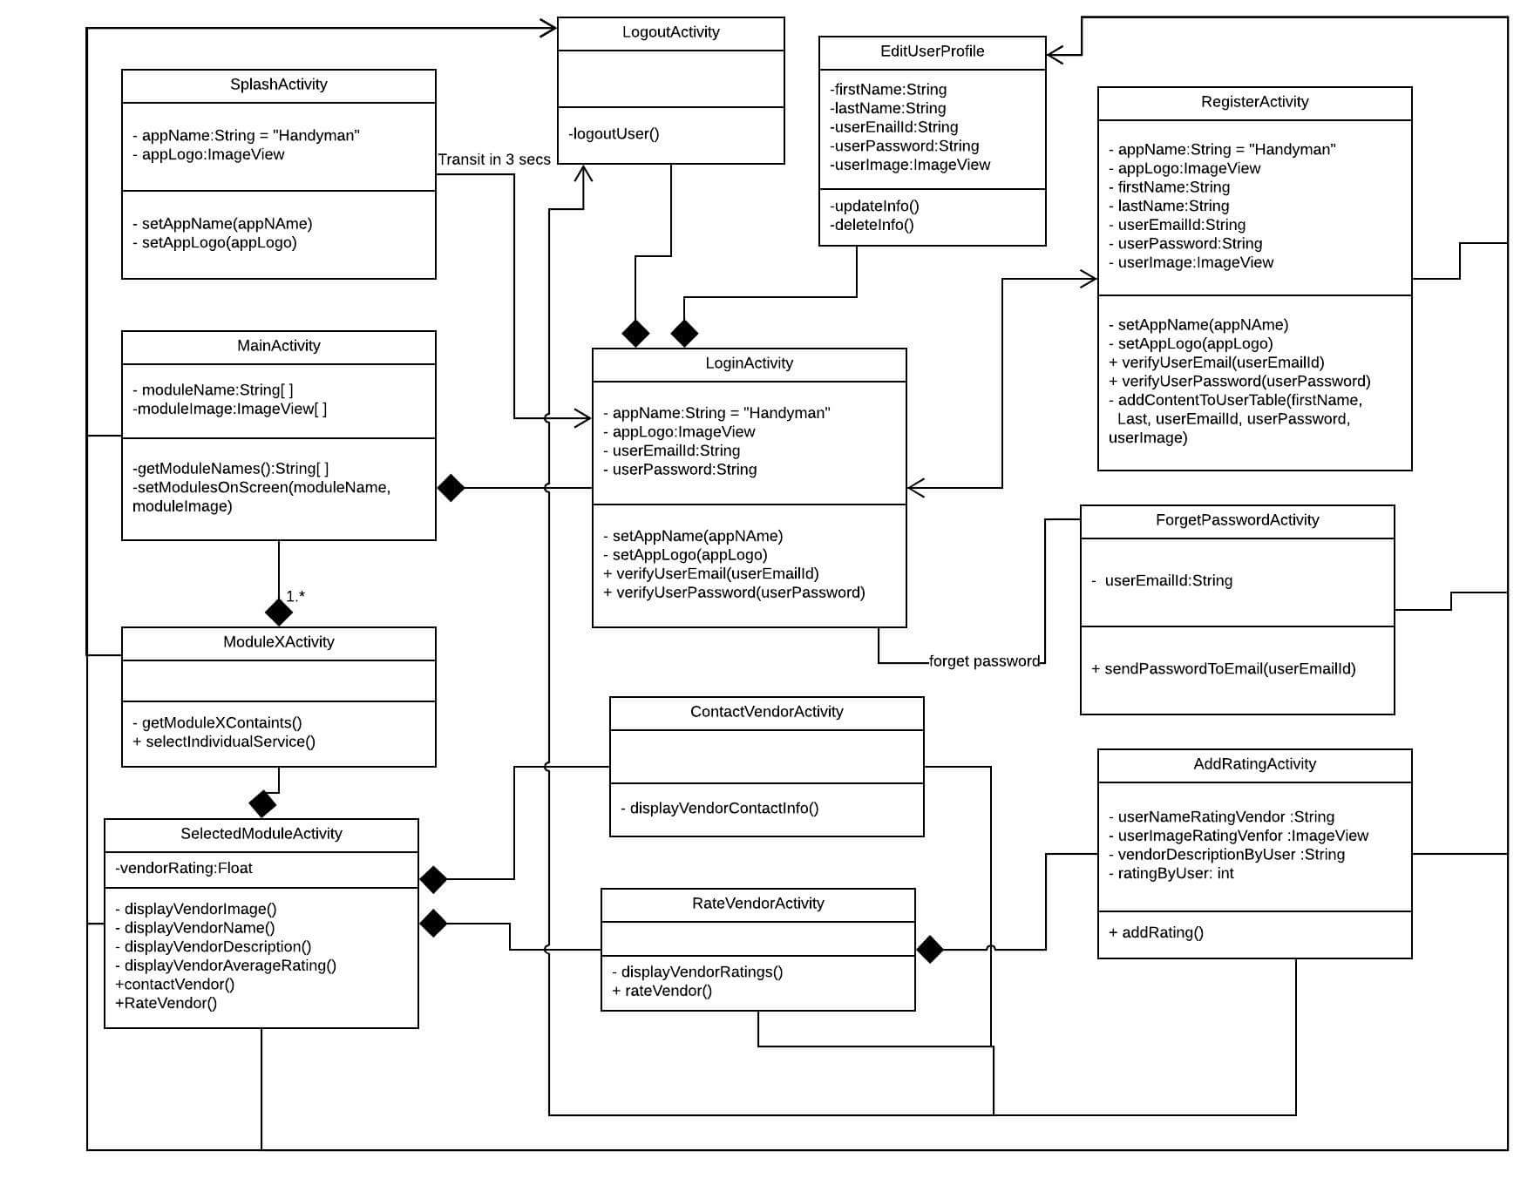
CLASS DIAGRAM

Slide 27
CLASS DIAGRAM

Slide 28
DATA DICTIONARY
CUSTOMER TABLE
VENDOR TABLE
ADMINISTRATOR TABLE
COMMENT TABLE

Slide 29
CUSTOMER TABLE
FIELD NAME | DATATYPE(SIZE) | CONSTRAINT | DESCRIPTION
fname | String | required | First Name of Customer
lname | String | required | Last Name of Customer
username | String | required, unique | Username of Customer
email | String | required, unique | Email id of Customer
password | String | required | Password of Customer

Slide 30
VENDOR TABLE
FIELDNAME | DATATYPE(SIZE) | CONSTRAINT | DESCRIPTION
fname | String | required | First Name of Vendor
lname | String | required | Last Name of Vendor
username | String | required, unique | Username of Vendor
email | String | required, unique | Email of Vendor
password | String | required | Password of Vendor
email | String | required | Email of Vendor
address | String | required | Address of Vendor
area | String | required | Area of Vendor
city | String | required | City of Vendor
state | String | required | State of Vendor
pincode | Number | required | Pincode of the selected area

Slide 31
VENDOR TABLE
FIELDNAME | DATATYPE(SIZE) | CONSTRAINT | DESCRIPTION
mobile | Number | required | Mobile Number of Vendor
service | String | required | Service of Vendor
subservice | String | required | Subservice of Vendor
description | String | required | Description of Vendor
experience | Number | required | Experience of Vendor
visitCharge | Number | required | Visit Charge of Vendor
image | String | required | Image of Vendor

Slide 32
COMMENT TABLE
FIELD NAME | DATATYPE(SIZE) | CONSTRAINT | DESCRIPTION
text | String | required | Comment by Customer
fname | String | required | First Name of Customer
lname | String | required | Last Name of Customer
username | String | required | Username of Customer
dateandtime | String | required | Date when Comment Posted

Slide 33
ADMINISTRATOR TABLE
FIELDNAME | DATATYPE(SIZE) | CONSTRAINT | DESCRIPTION
username | String | required, unique | Username of Admin
email | String | required, unique | Email of Admin
password | String | required | Password of Admin

Slide 34
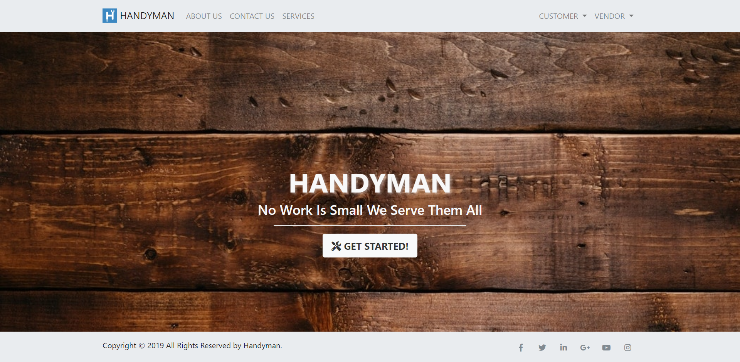
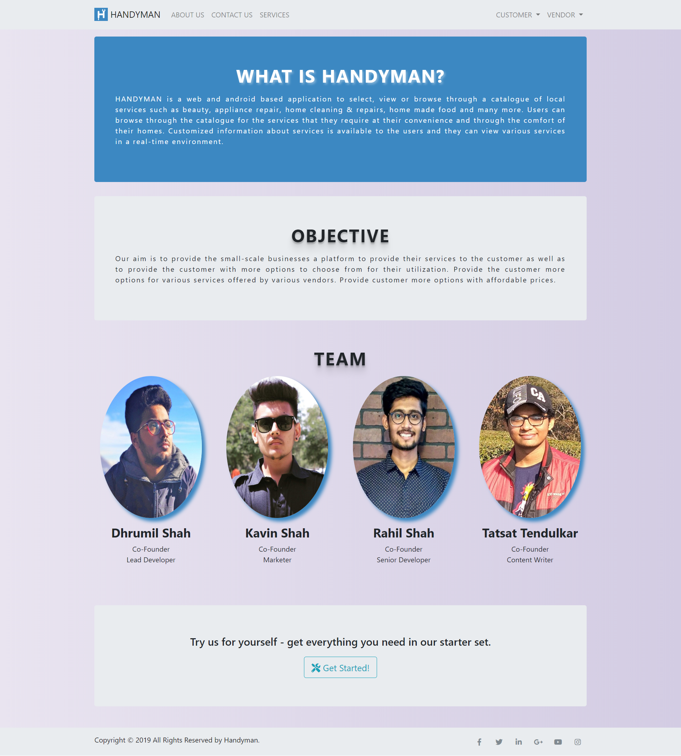
SNAPSHOTS
Handyman landing page
About us page

Slide 35
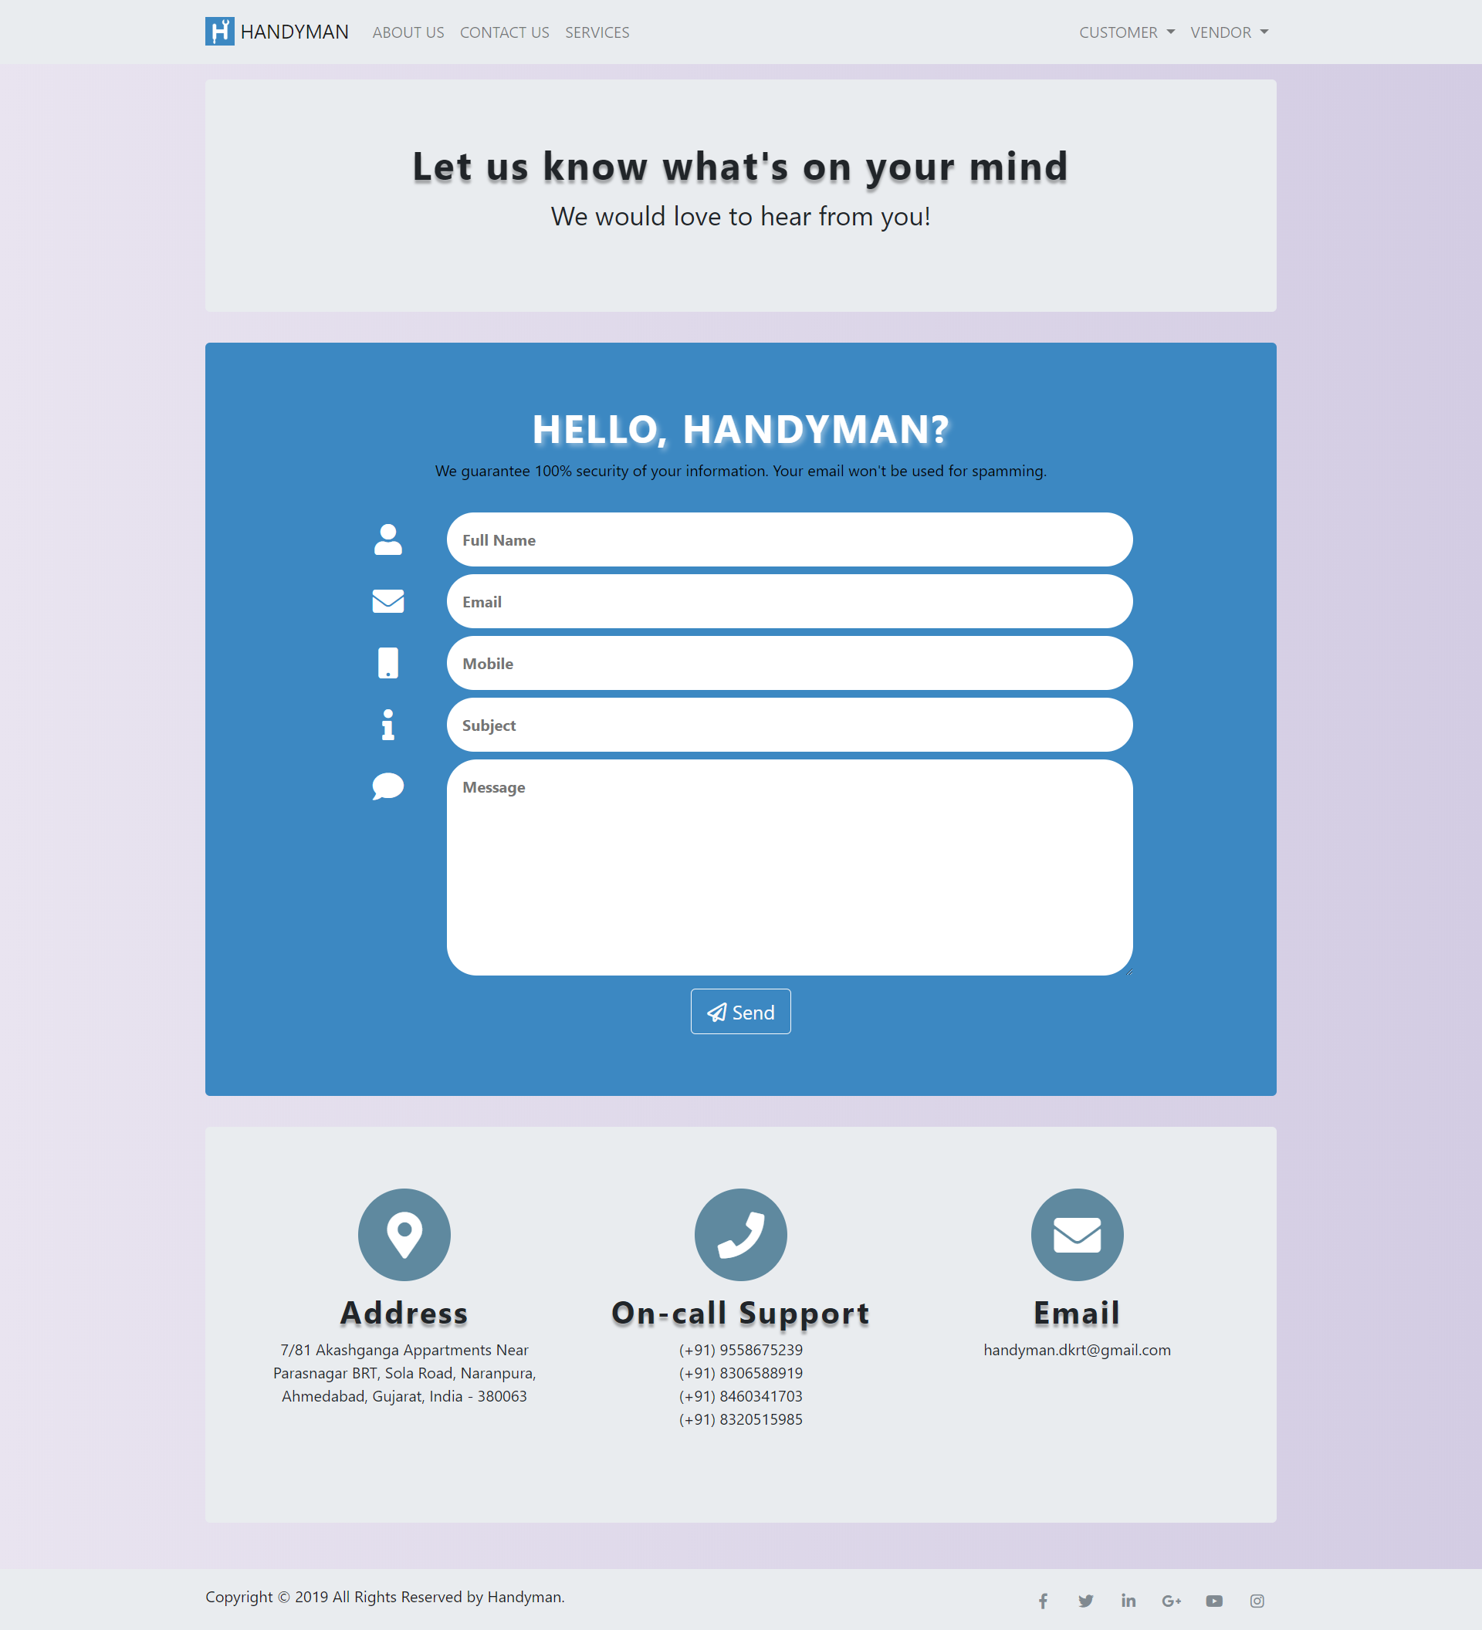
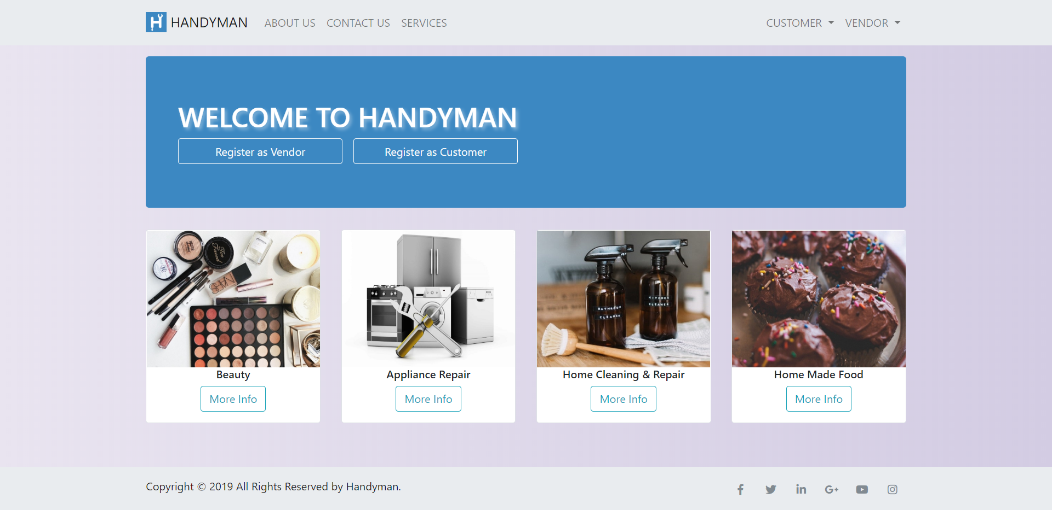
Contact us page
Services page

Slide 36
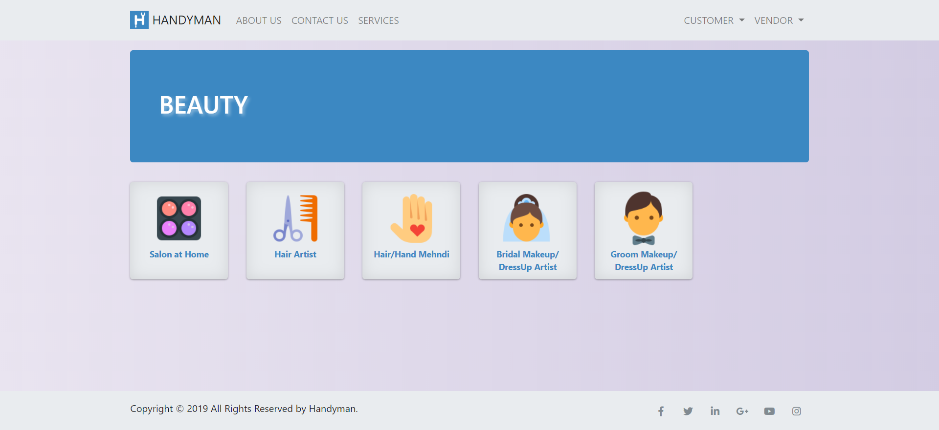
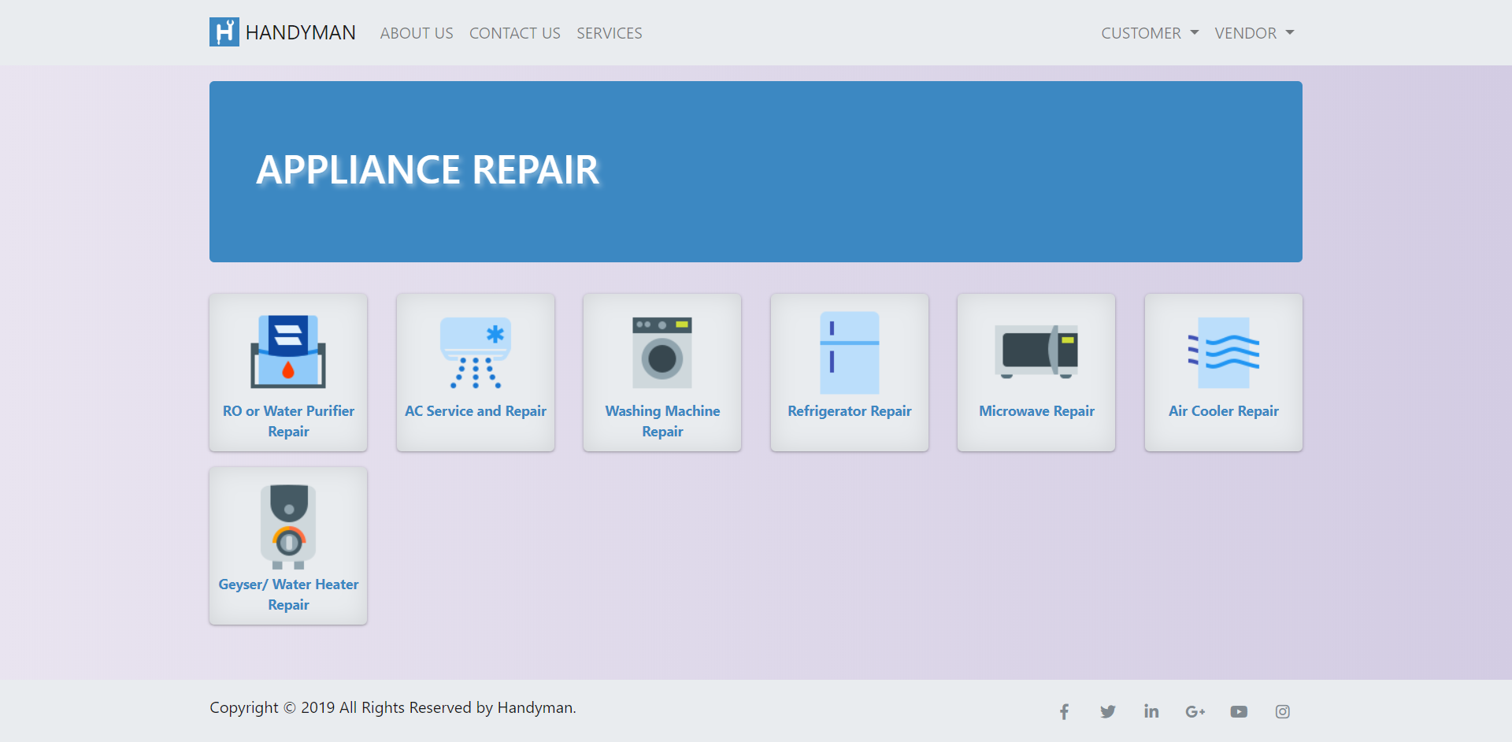
Beauty page
Appliance repair page

Slide 37
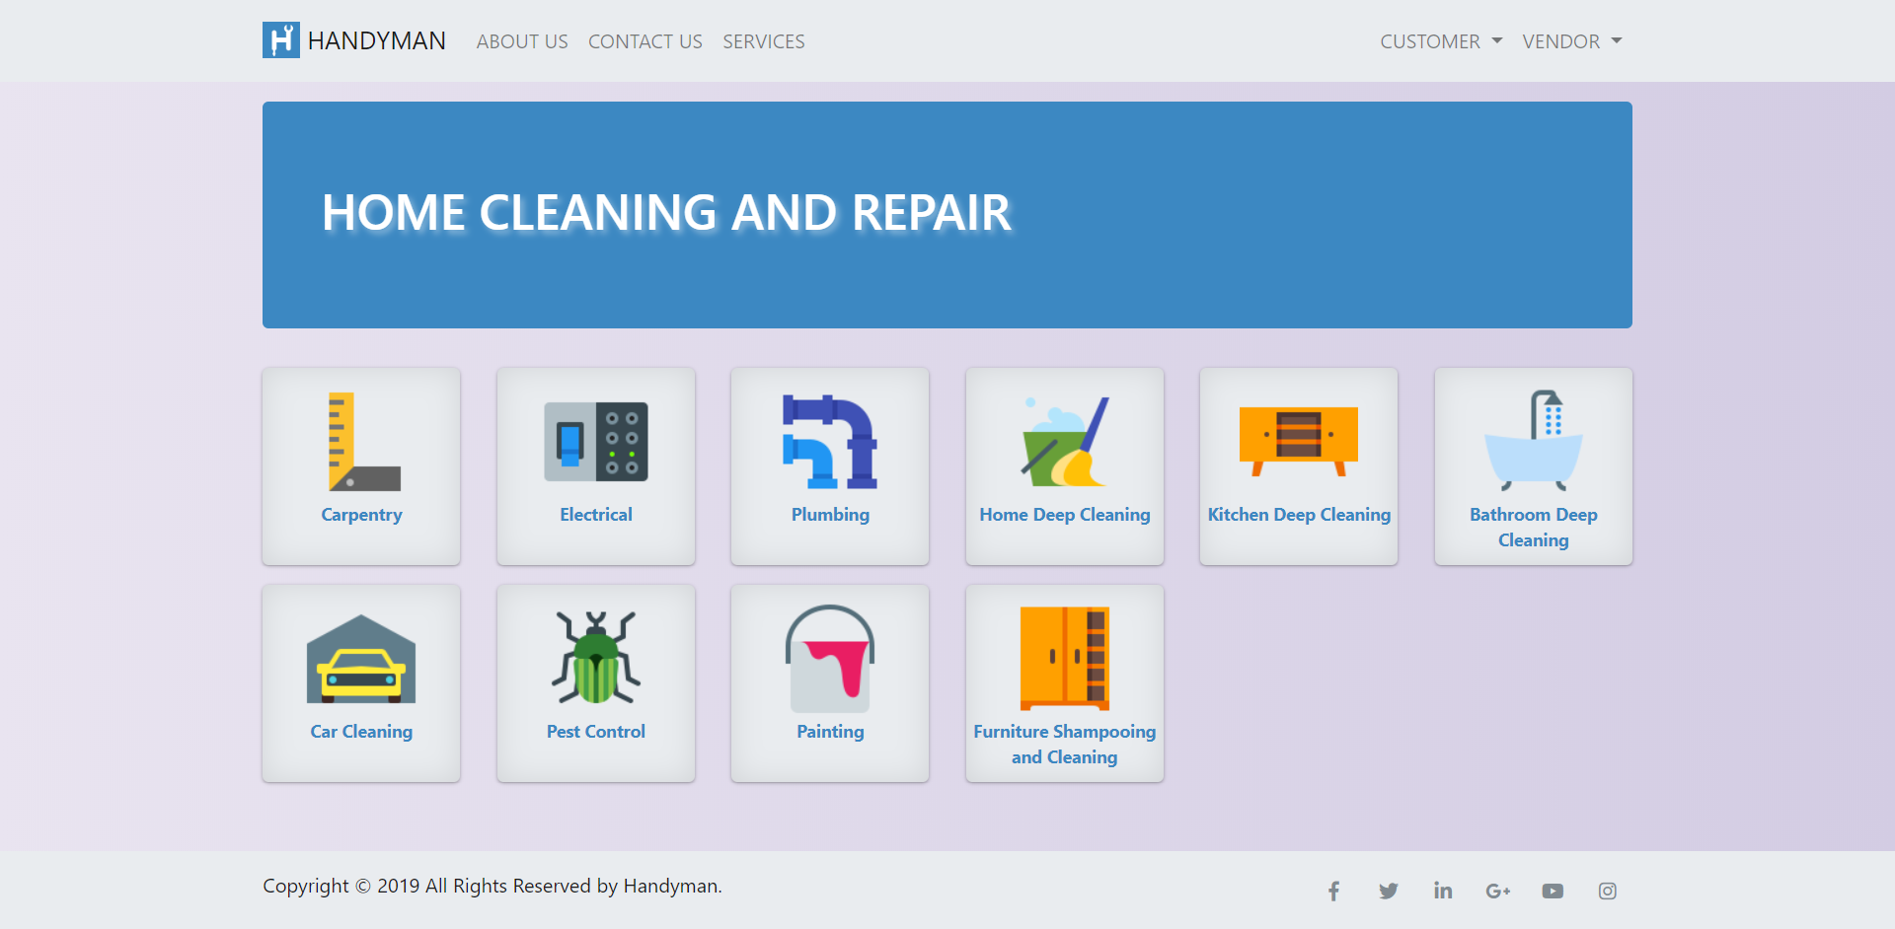
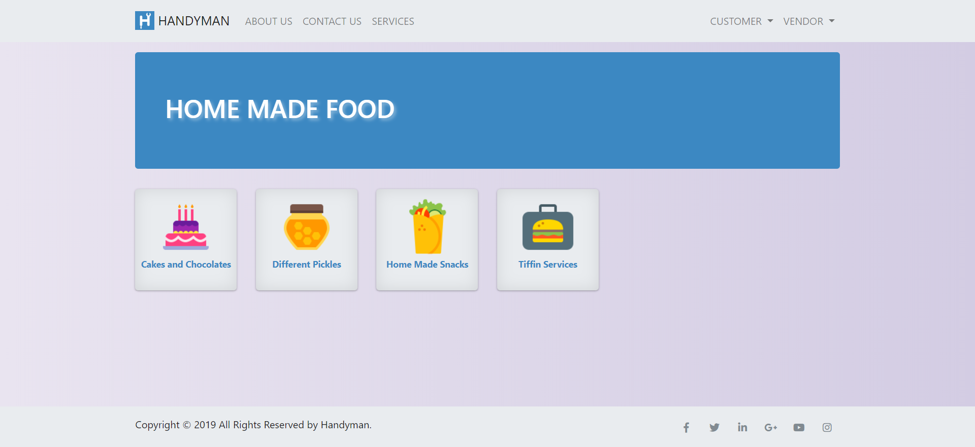
Home cleaning and repair page
Home made food page

Slide 38
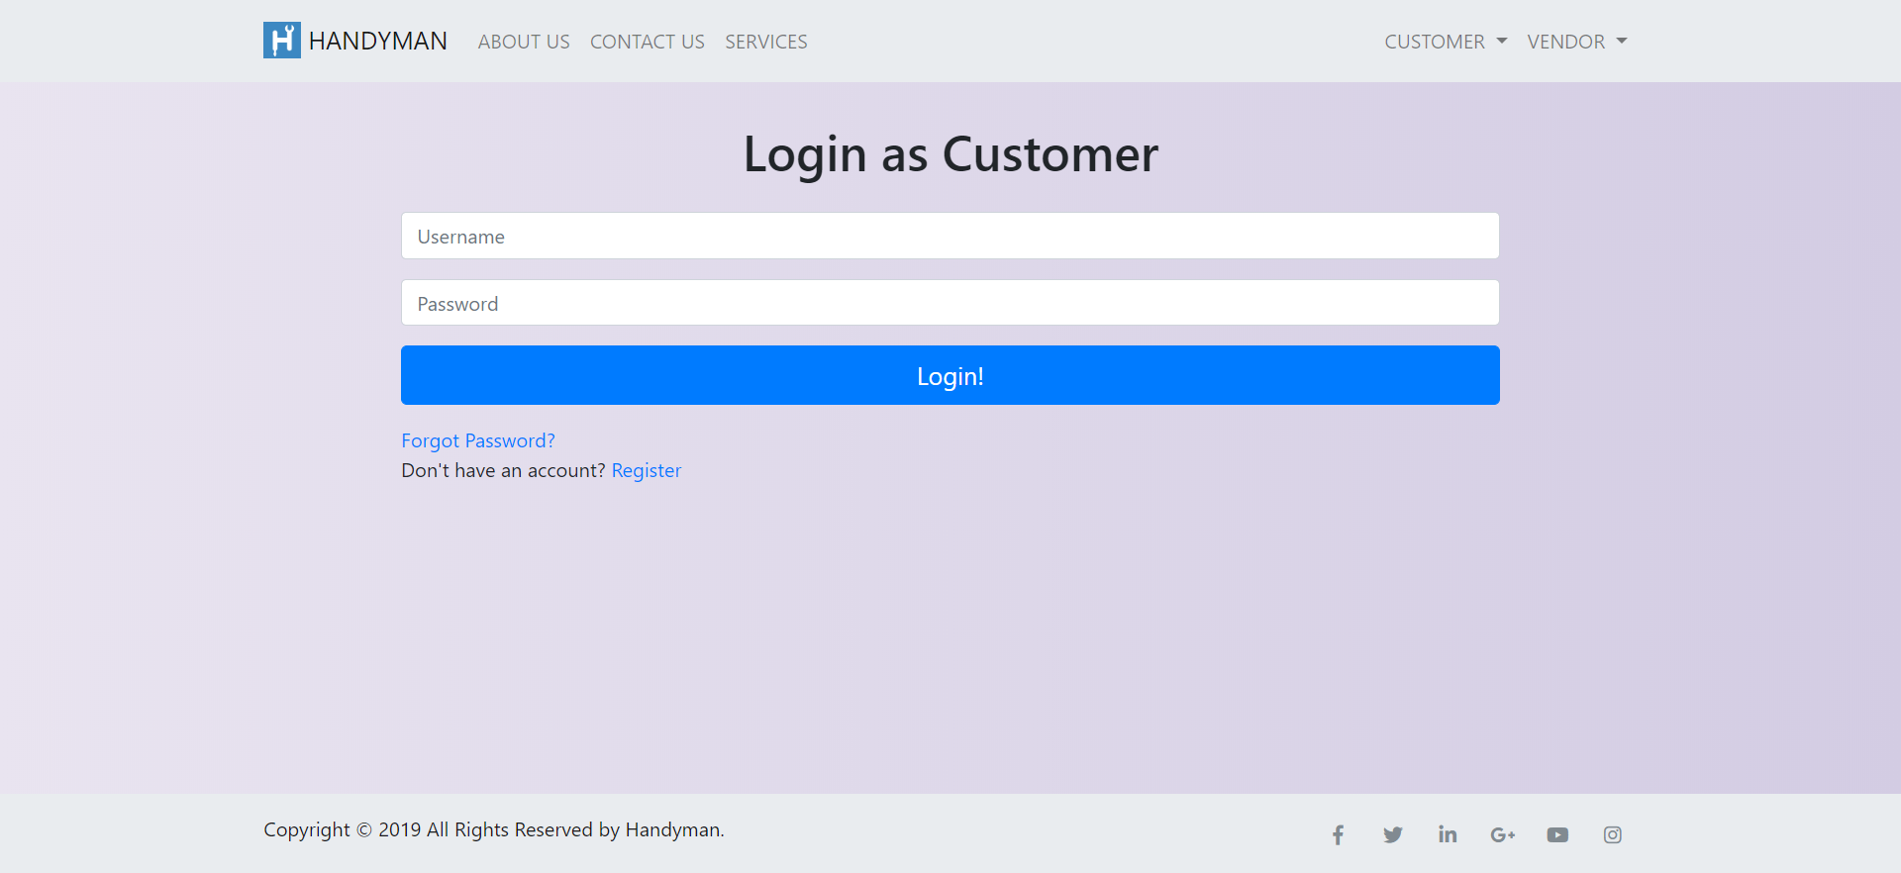

Customer login page
Vendor login page

Slide 39
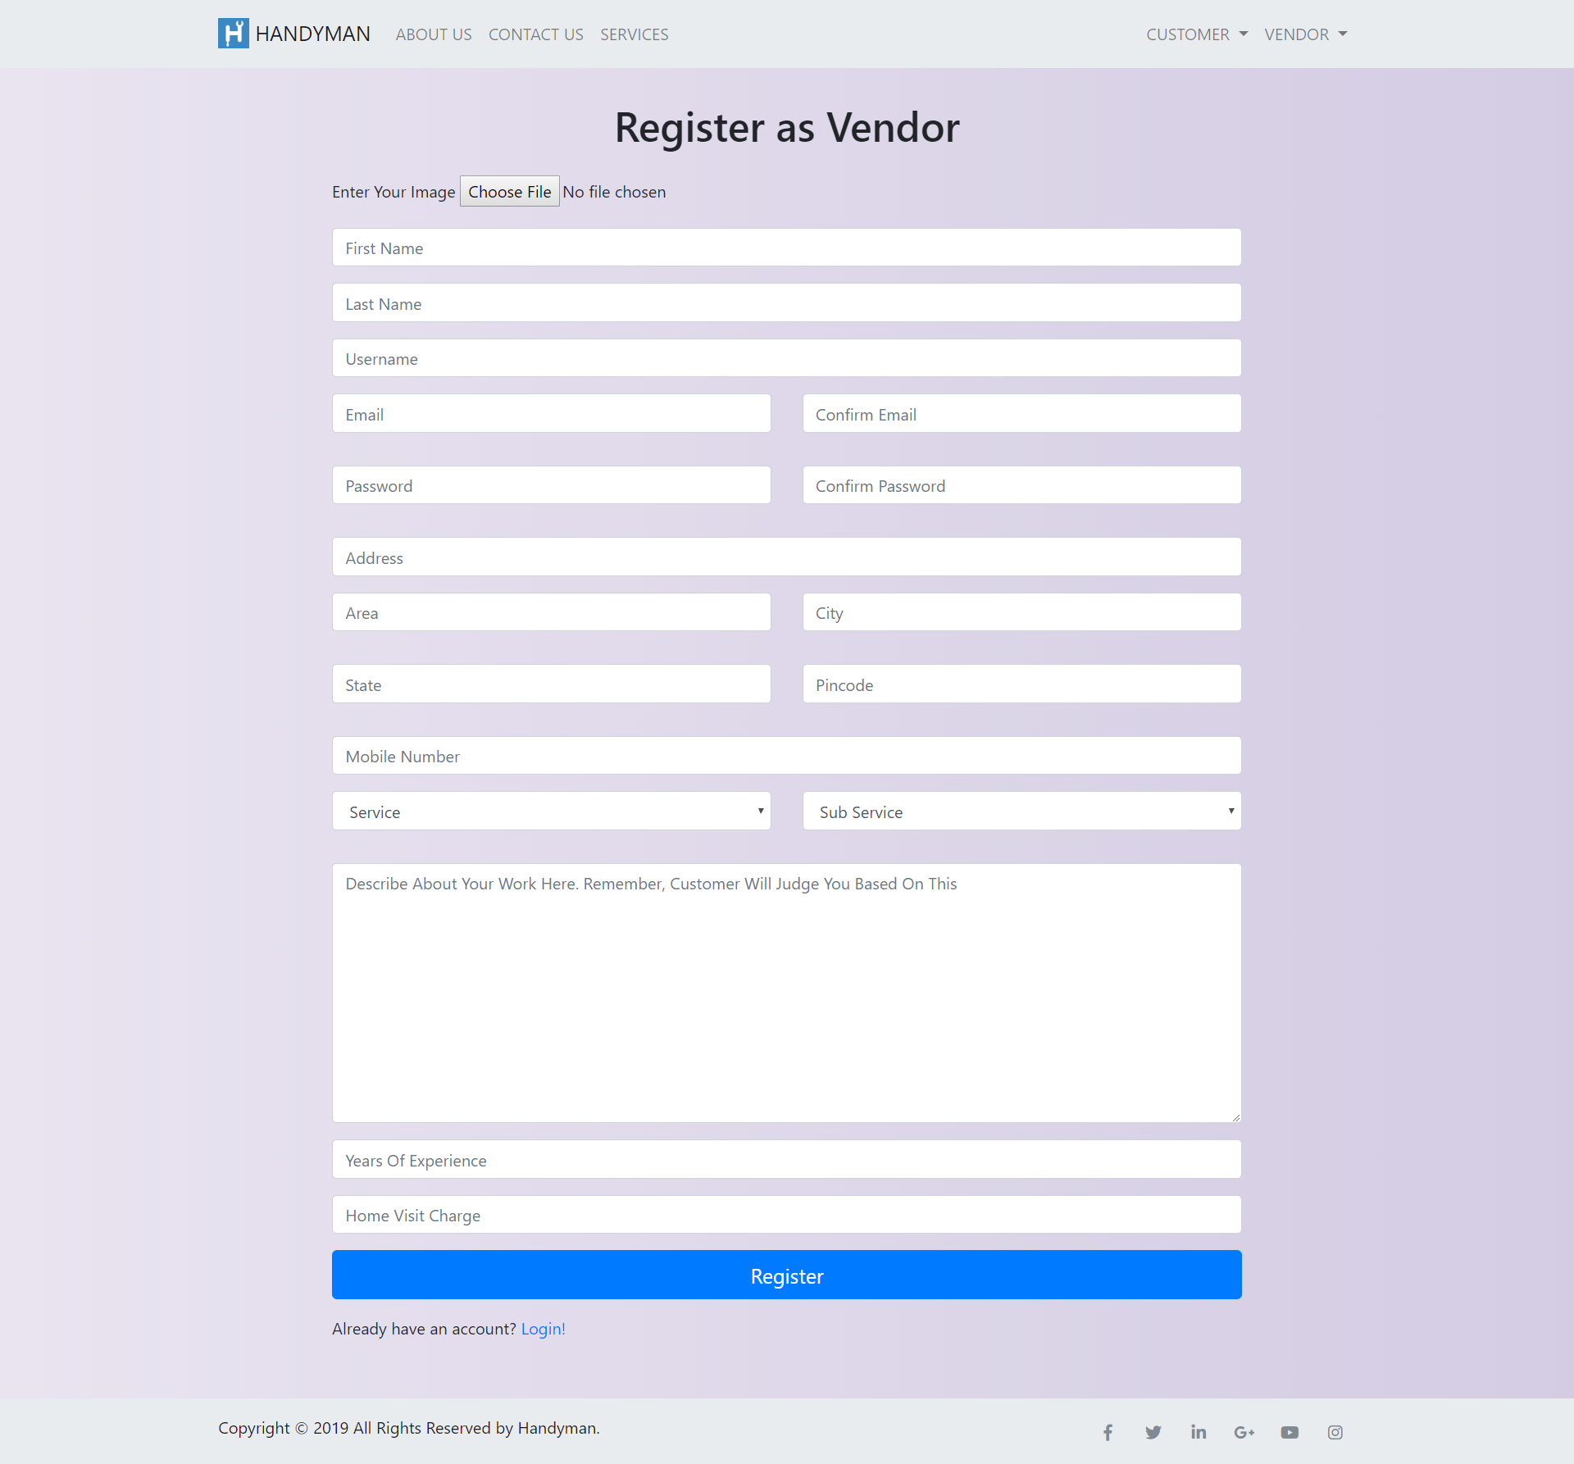
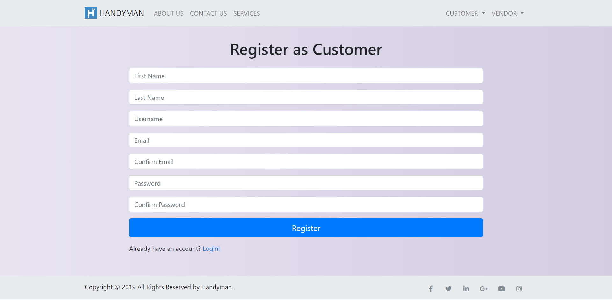
Customer registration page
Vendor registration page

Slide 40
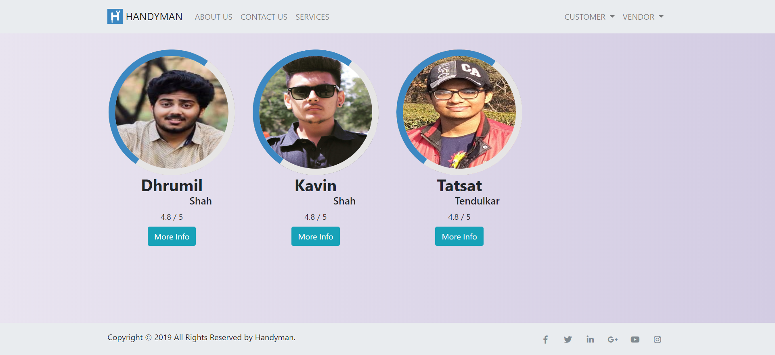
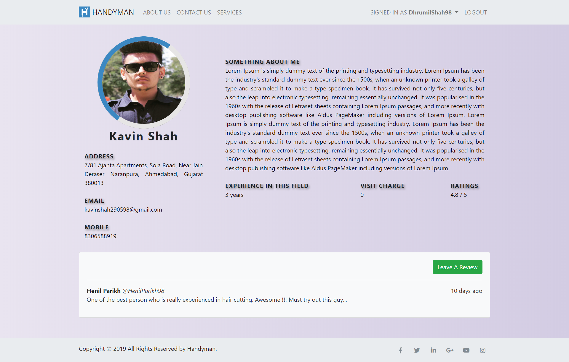
Vendors list page
Vendor details page

Slide 41
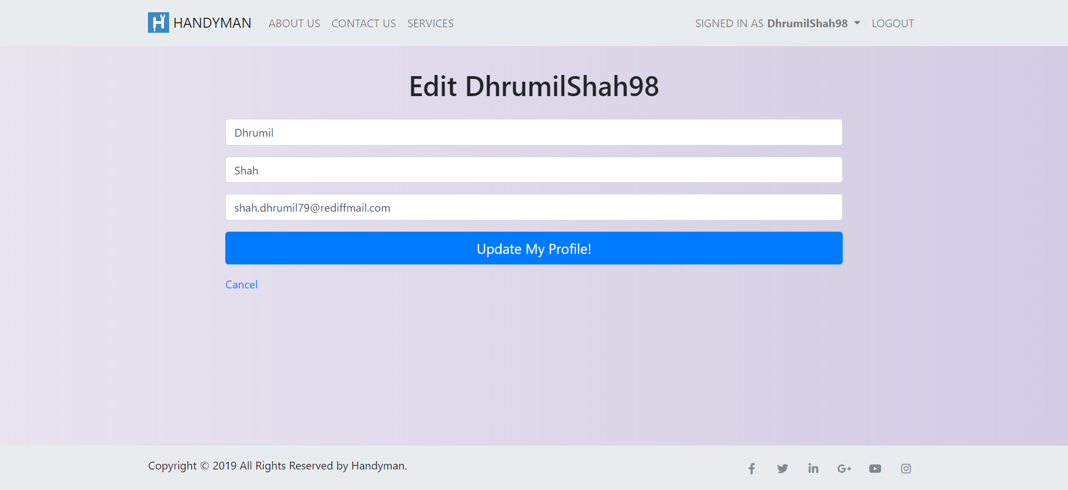
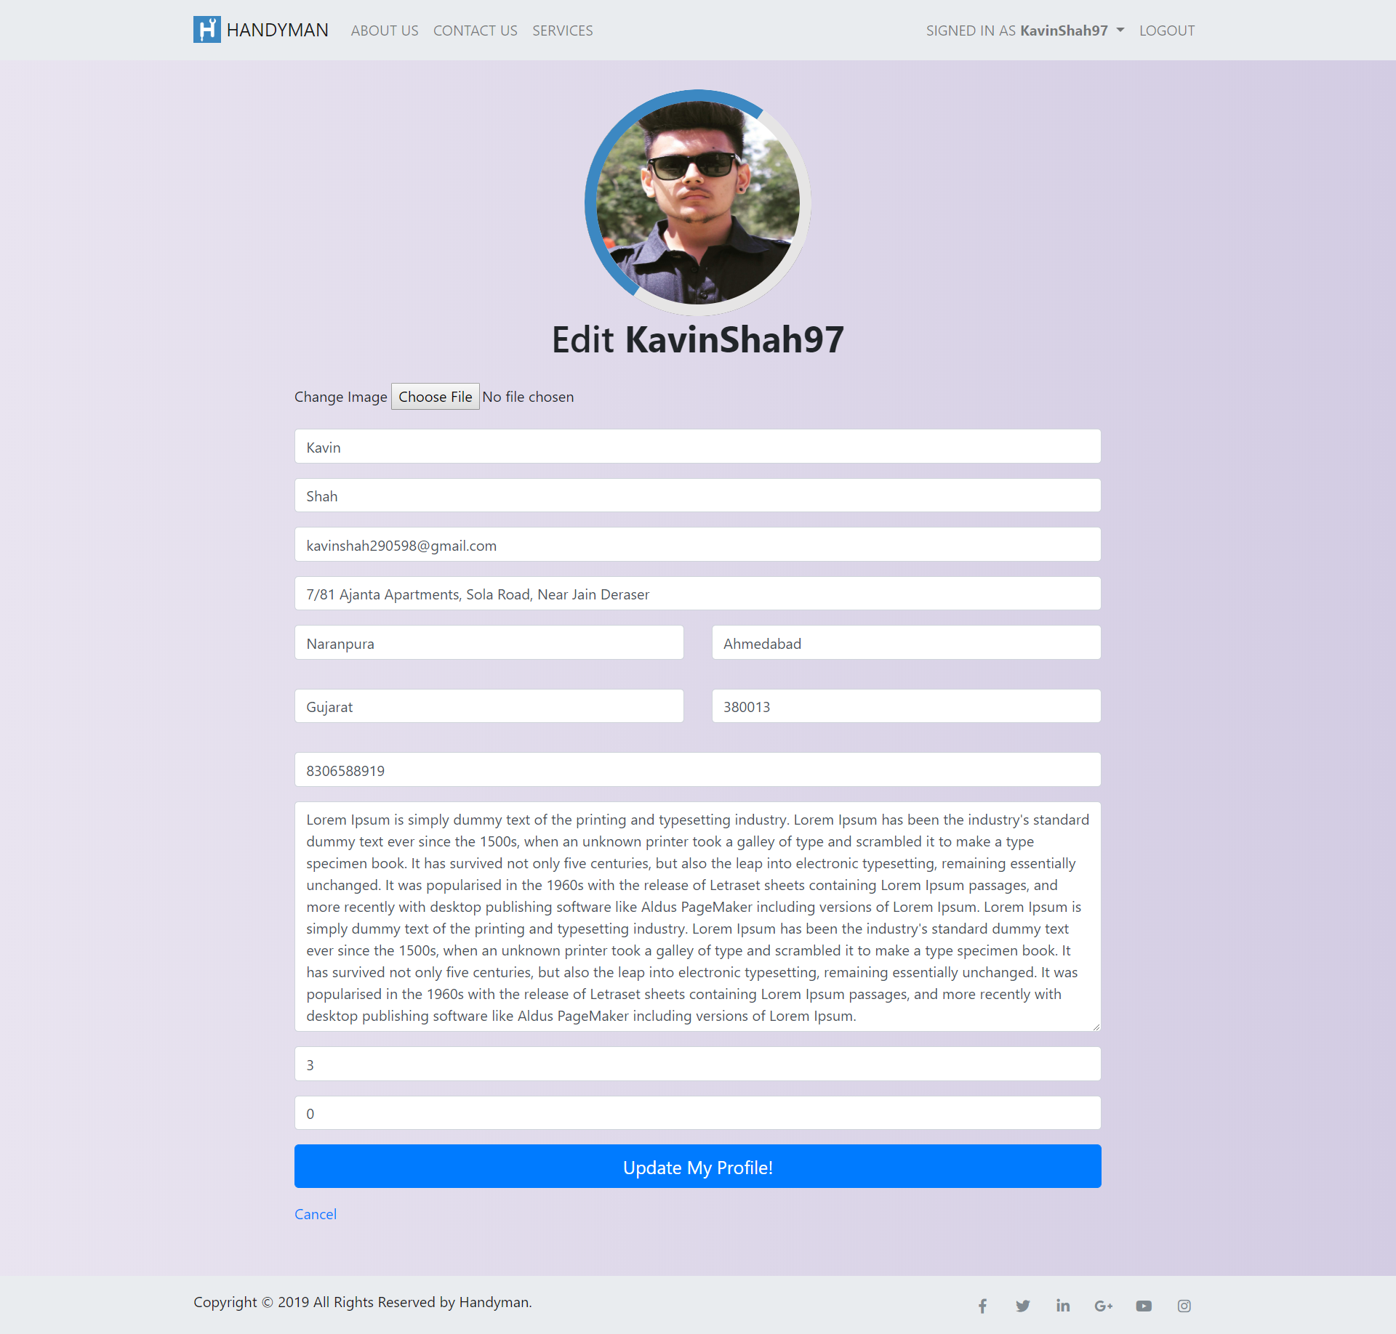
Edit customer profile
Edit vendor profile

Slide 42
FUTURE ENHANCEMENTS
The project can be implemented on State level as well as the Country level. Currently it is for Ahmedabad only.
Also a feature can be included where the payment gateway can be implemented within the application itself.
The reason why the expansion of the project will be less challenging is, since the concept is Object oriented new models can be integrated without changing old modules.

Slide 43
CONCLUSION
To conclude, Handyman works like a directory which allows Customers and Vendors to connect directly.
Handyman allows small-scale vendors to grow their business directly and provide them a platform to do it.
Handyman allows its users to establish professional contacts between each other.
Handyman has low pricing which allows its customers to enjoy more benefits.

Slide 44
REFERENCES
GOOGLE
WIKIPEDIA
YOUTUBE
FOCUS GROUPS
GROUP SURVEYS
URBAN CLAP
CUSTOMER INTERACTION

Slide 45
PARAMETER | REFERENCE
Application Reference | https://www.urbanclap.com/ (UrbanClap) https://www.housejoy.in/ (Housejoy) https://bro4u.com/ (bro4u) https://www.taskrabbit.com/ (Task Rabbit)
Android and Web Courses | https://in.udacity.com/ (Udacity) https://www.udemy.com/ (Udemy) https://www.coursera.org/ (Coursera)
YouTube videos | https://www.youtube.com/watch?v=zid-MVo7M-E (Usecase Diagram) https://www.youtube.com/watch?v=UI6lqHOVHic (Class Diagram)
Reference Book | Roger S Pressman, McGrawHill Publication

Slide 46

THANK YOU…!

